Slide 1
Circuit and Digital Logic
Associate Professor
Dr. Juan Chen
School of Computer Science and Engineering
University of Electronic Science and Technology of China

Slide 2
QQ Group for Our Course
Please change your nickname as: your real name + student number

Slide 3
Grading Policy
Final Exam: 40%
Usual Performance: 60%

Slide 4
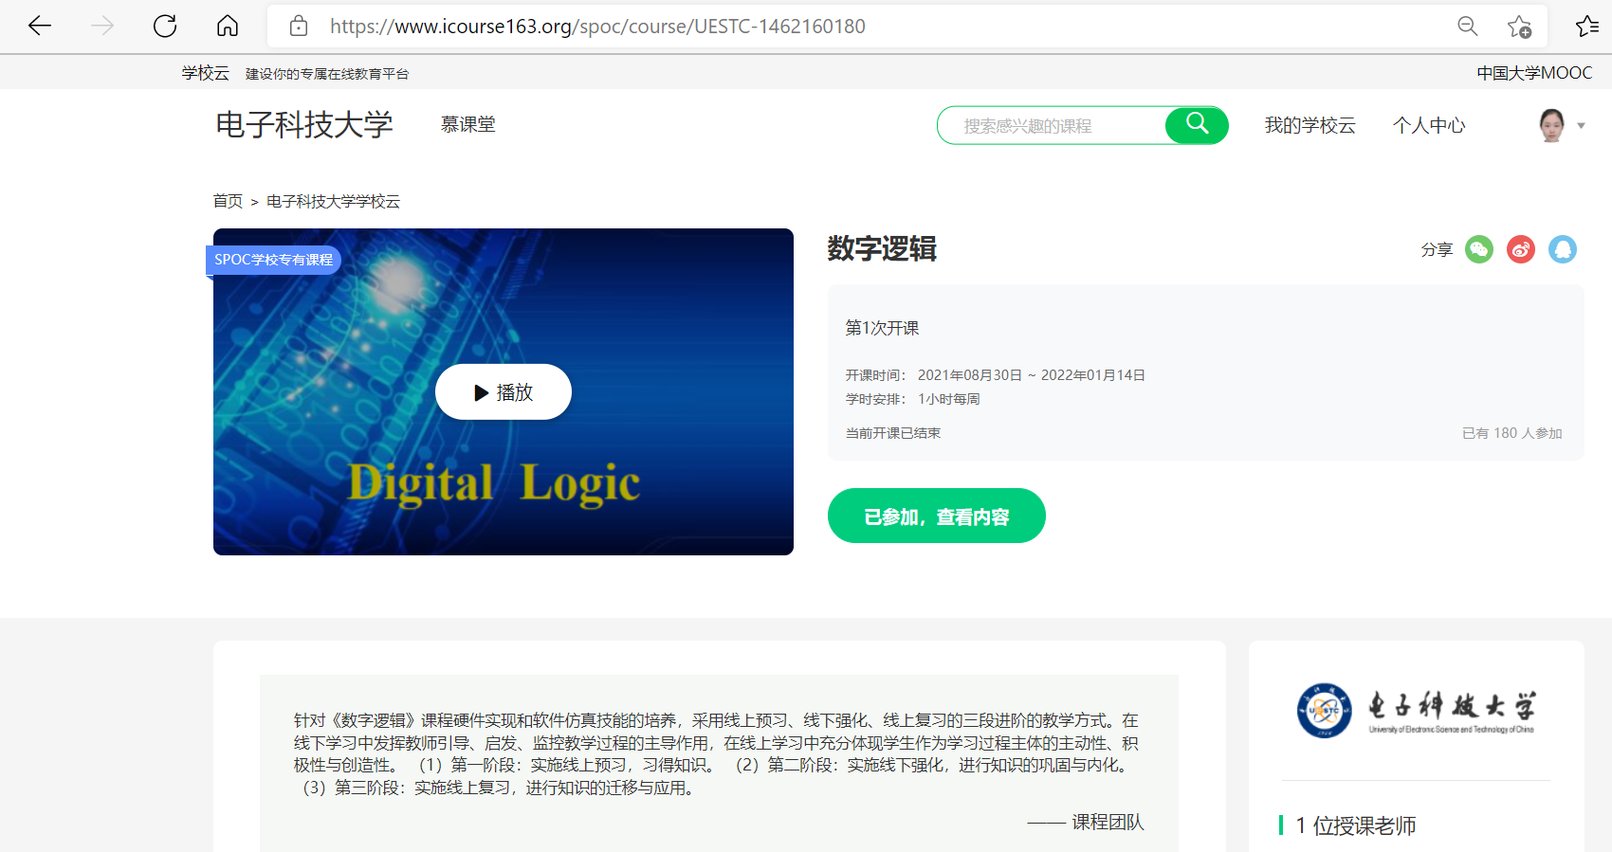
SPOC: online learning resource
https://www.icourse163.org/spoc/course/UESTC-1462160180
Password：DigitalLogic

Slide 5
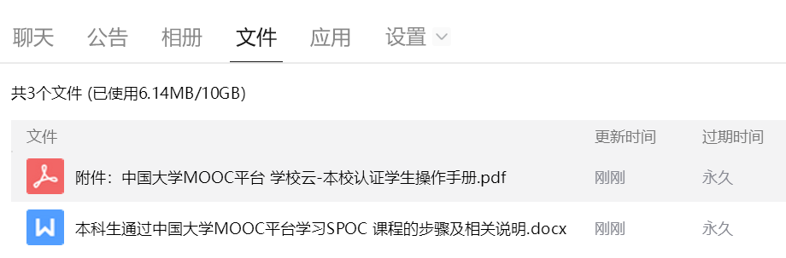
Log In SPOC
Verify your account and register SPOC

Slide 6
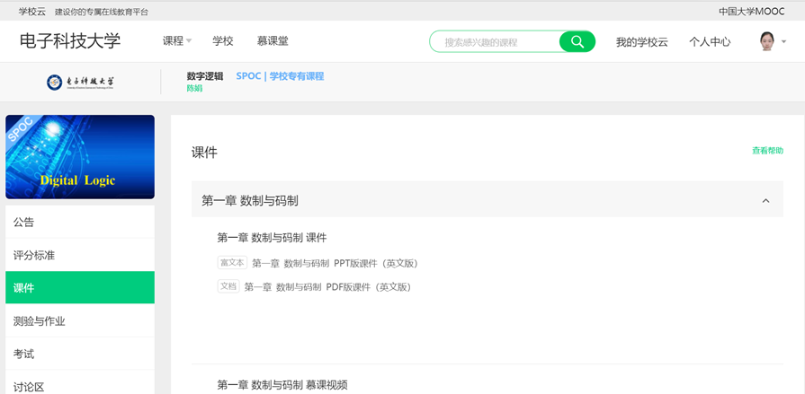
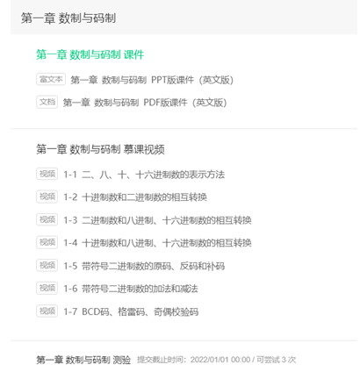

Slide 7
In this course you will study:
How is the computer working?
This course is all about numbers, functions and logic circuits.

Slide 8


Tour of Circuit and Digital Logic
1st Tour:
Number Systems
2nd Tour:
Logic Functions
3rd Tour:
Logic Circuits

Slide 9

Tour of Circuit and Digital Logic
1st Tour:
Number Systems
(?)₁₀←→(?)₂←→(?)₈←→(?)₁₆
(110011010100)₂
(110 011 010 100)₂: octal number (6324)₈
(1100 1101 0100)₂: hex number (CD4)₁₆
decimal number (3284)₁₀

Slide 10

Tour of Circuit and Digital Logic
2nd Tour:
Logic Functions
10001001…000111: X₁, …, X_{n}
11110011…100010: Y₁, …, Y_{m}
1: ON, 0: OFF
X₁, …, X_{n}: input
Y₁, …, Y_{m}: output
Y_{j} = f (X₁, …, X_{n}), f: logic function

Slide 11

Tour of Circuit and Digital Logic
Numbers
(Information)
Job for Computer
(e.g. Chatting)
Functions
(Operations)
What’s the weather today?
Robot: Sunny.

Slide 12
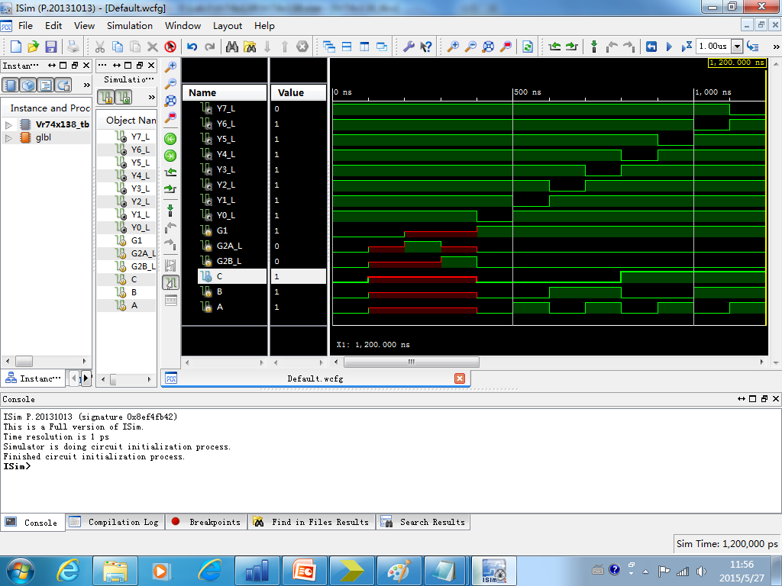
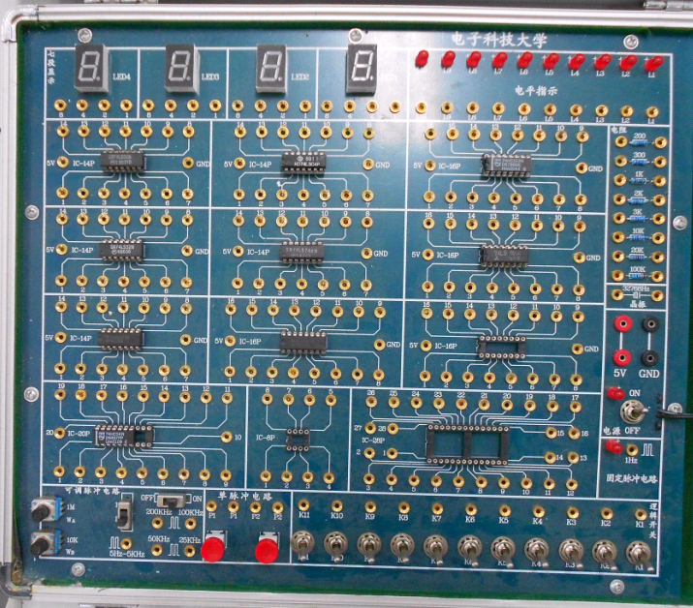
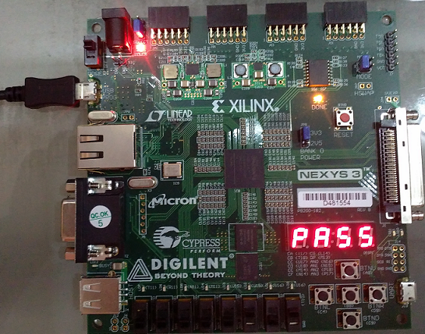
Tour of Circuit and Digital Logic
How to demonstrate the job result?
3rd Tour:
Logic Circuits
Software Simulation: Verilog
Hardware Implementation: CMOS Transistors
Industrial Product: Memory, Programmable Logic Device

Slide 13
Course Chapters
Chapter One: Number Systems and Codes
Chapter Two: Logical Algebra
Chapter Three: Digital Circuit
Chapter Four: Combinational Logic Circuit
Chapter Five: Flip-Flop
Chapter Six: Synchronous Sequential Logic Circuit
Chapter Seven: Verilog Implementation of Logic Circuit
Chapter Eight: Memory and Programmable Logic Device

Slide 14
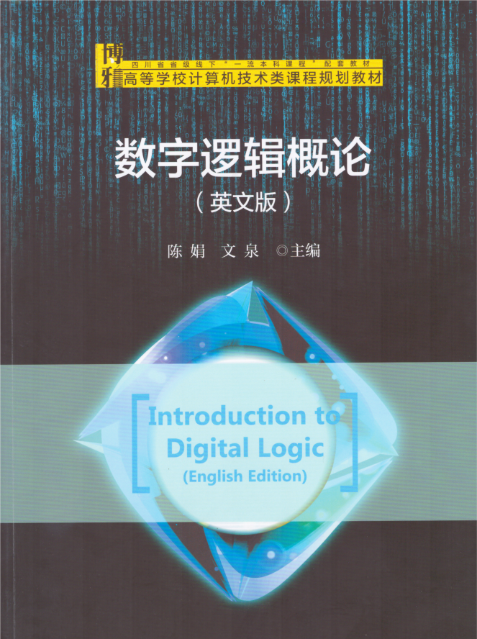
Textbook
Introduction to Digital Logic, Peking University Press, 2023.10, the 1st edition
Juan Chen, Quan Wen
ISBN 978-7-301-34369-2

Slide 15
Chapter One: Number Systems and Codes

Slide 16
Chapter 1
Number Systems and Codes
1.1 Number Systems
1.2 Number Conversion
1.3 Signed Binary Numbers
1.4 Addition and Subtraction of Signed Binary Numbers
1.5 Numerical Codes

Slide 17
1.1 Number Systems
1.1.1 Decimal Number (Base 10)
(1) Base: 10, Counting Symbols: 0～9
(2) Weight for the i^{th} digit: 10^{i}
Weighted Expansion (m integers, n fractional digits):
Notes:
Decimal number. The base is 10. It counts from 0 to 9. Alpha is the counting symbol.
For integers, the exponent starts from 0 and is increased by 1.
For decimals, the exponent starts from -1 and is decreased by 1.

Slide 18
1.1 Number Systems
1.1.1 Decimal Number (Base 10)
(1) Base: 10, Counting Symbols: 0～9
(2) Weight for the i^{th} digit: 10^{i}
Weighted Expansion (m integers, n fractional digits):
Notes:
Decimal number. The base is 10. It counts from 0 to 9. Alpha is the counting symbol.
For integers, the exponent starts from 0 and is increased by 1.
For decimals, the exponent starts from -1 and is decreased by 1.

Slide 19
How to write the weighted expansion of a decimal number ?
Example:
256.7
=2×10²＋5×10¹＋6×10⁰＋7×10^{－1}
Notes:
Look at the decimal number 256.7.
The base is 10.
For integers, the exponent starts from 0.
For decimals, the exponent starts from -1.

Slide 20
1.1.2 Binary Number (Base 2)
(1) Base: 2, Counting Symbols: 0～1
(2) Weight for the i^{th} digit: 2^{i}
Weighted Expansion (m integers, n fractional digits):

Slide 21
1.1.2 Binary Number (Base 2)
(1) Base: 2, Counting Symbols: 0～1
(2) Weight for the i^{th} digit: 2^{i}
Weighted Expansion (m integers, n fractional digits):

Slide 22
How to write the weighted expansion of a binary number ?
Example:
(101.1)₂
=1×2²＋0×2¹＋1×2⁰＋1×2⁻¹
=(5.5)₁₀

Slide 23
1.1.3 Octal Number (Base 8)
(1) Base: 8, Counting Symbols: 0～7
(2) Weight for the i^{th} digit: 8^{i}
Weighted Expansion (m integers, n fractional digits):

Slide 24
1.1.3 Octal Number (Base 8)
(1) Base: 8, Counting Symbols: 0～7
(2) Weight for the i^{th} digit: 8^{i}
Weighted Expansion (m integers, n fractional digits):

Slide 25
How to write the weighted expansion of an octal number ?
Example:
(12.4)₈
=1×8¹＋2×8⁰＋4×8^{－1}
=(10.5)₁₀

Slide 26
Weights
8 4 2 1
= 2³ 2² 2¹ 2⁰
Hexadecimal
Number
Binary
Number
Decimal
Number
A
B
C
D
E
F
1010
1011
1100
1101
1110
1111
10
11
12
13
14
15

Slide 27
1.1.4 Hexadecimal Number (Base 16)
(1) Base: 16, Counting Symbols: 0～F
1010
1011
1100
1101
1110
1111
10
11
12
13
14
15
A
B
C
D
E
F
(2) Weight for the i^{th} digit: 16^{i}
Weighted Expansion (m integers, n fractional digits):

Slide 28
1.1.4 Hexadecimal Number (Base 16)
(1) Base: 16, Counting Symbols: 0～F
1010
1011
1100
1101
1110
1111
10
11
12
13
14
15
A
B
C
D
E
F
(2) Weight for the i^{th} digit: 16^{i}
Weighted Expansion (m integers, n fractional digits):

Slide 29
How to write the weighted expansion of a hexadecimal number ?
e.g.
(3A6)₁₆
=3×16²＋10×16¹＋6×16⁰
=(934)₁₀

Slide 30
1.2 Number Conversion
1.2.1 Conversion Between Binary and Decimal
(1) Conversion from Decimal to Binary
Integer part: divided by 2 to get the remainder until the quotient is 0.
Fractional part: multiplied by 2 to get integers until the fractional part is 0 (or the required precision is reached).
Notes:
Convert decimal number to binary number.
The integer part is divided by 2. Take the remainders.
The decimal part is multiplied by 2. Take the resulted integers.

Slide 31
Example: (25.875)₁₀＝(11001.111)₂
2
25
Remainder
2
12
1 a₀
2
6
0 a₁
2
3
0 a₂
2
1 a₃
1
0
1 a₄
Quotient
Notes:
25 is divided by 2. The 1st remainder is the lowest bit of the target number.
The last remainder is the highest bit of the target number.
The key point. 1 is less than 2. Now, the quotient is 0. The division ends.

Slide 32
e.g. (25.875)₁₀＝(11001.111)₂
0.875
× 2 Integer
1.750 1 (a₋₁)
0.750
× 2
1.50 1 (a₋₂)
0.50
× 2
1.0 1 (a₋₃)
0.0

Slide 33
Exercise

Slide 34
(1) Conversion from Decimal to Binary
(179)₁₀ =10110011₂
179÷2=89 Remainder 1
lower bit
89÷2=44 1
44÷2=22 0
When quotient is 0, stop!
22÷2=11 0
11÷2=5 1
5÷2=2 1
2÷2=1 0
higher bit
1÷2=0 1

Slide 35
(2) Conversion from Binary to Decimal
How?
Calculate the weighted expansion of the binary number.
Example:
(11.1)₂
=1×2¹＋1×2⁰＋1×2⁻¹ =(3.5)₁₀

Slide 36
Exercise

Slide 37
(2) Conversion from Binary to Decimal
(10011)₂
=1×2⁴＋0×2³＋0×2²＋1×2¹＋1×2⁰
=16+2+1=19₁₀
(100010)₂
=1×2⁵＋0×2⁴＋0×2³＋0×2²＋1×2¹＋0×2⁰
=32+2=34₁₀
(101.001)₂
=1×2²＋0×2¹＋1×2⁰＋0×2⁻¹＋0×2⁻²＋1×2⁻³
=4+1+1/8=5.125₁₀

Slide 38
1.2.2 Conversion of Binary, Octal and Hexadecimal
(1) Conversion from Binary to Octal
Example: (1 011 101.011 010 1)₂
=(135.324)₈
From the radix point, put three bits in a group. Add 0 to the head or tail if the digits are inadequate to form a group.

Slide 39
(2) Conversion from Binary to Hexadecimal
1010
1011
1100
1101
1110
1111
10
11
12
13
14
15
A
B
C
D
E
F
Example:
(101 1101.0110 101)₂
=(5D.6A)₁₆
From the radix point, put four bits in a group. Add 0 to the head or tail if the digits are inadequate to form a group.

Slide 40
(3) Conversion from Octal to Binary
Example: (135.324)₈
=(1 011 101.011 010 1)₂
Replace each octal counting symbol with 3 bits.

Slide 41
(4) Conversion from Hexadecimal to Binary
1010
1011
1100
1101
1110
1111
10
11
12
13
14
15
A
B
C
D
E
F
Example:
(5D.6A)₁₆
=(101 1101.0110 101)₂
Replace each hex counting symbol with 4 bits.

Slide 42
Exercise

Slide 43
(1) Conversion from Binary to Octal
(100011001110)₂
=(100 011 001 110)₂
=4316₈
(11101101110101001)₂
=(011 101 101 110 101 001)₂
=355651₈
(10.1011001011)₂
=(010.101 100 101 100)₂
=2.5454₈

Slide 44
(2) Conversion from Binary to Hexadecimal
(100011001110)₂
=(1000 1100 1110)₂
=8CE₁₆
1010
1011
1100
1101
1110
1111
10
11
12
13
14
15
A
B
C
D
E
F
(11101101110101001)₂
=(0001 1101 1011 1010 1001)₂
=1DBA9₁₆
(10.1011001011)₂
=(0010.1011 0010 1100)₂
=2.B2C₁₆

Slide 45
(3) Conversion from Octal to Binary
(1357)₈
=001 011 101 111₂
= 1 011 101 111₂
(2046.17)₈
=010 000 100 110 . 001 111₂
= 10 000 100 110 . 001 111₂

Slide 46
(4) Conversion from Hexadecimal to Binary
1010
1011
1100
1101
1110
1111
10
11
12
13
14
15
A
B
C
D
E
F
(BEAD)₁₆
=1011 1110 1010 1101₂
(9F.46C)₁₆
=1001 1111 . 0100 0110 1100₂
=1001 1111 . 0100 0110 11₂

Slide 47
1.2.3 Conversion of Decimal, Octal and Hexadecimal
(1) Conversion from Decimal to Octal
Integer part: divided by 8 to get the remainder until the quotient is 0.
Fractional part: multiplied by 8 to get integers until the fractional part is 0 (or the required precision is reached).

Slide 48
(2) Conversion from Decimal to Hexadecimal
Integer part: divided by 16 to get the remainder until the quotient is 0.
Fractional part: multiplied by 16 to get integers until the fractional part is 0 (or the required precision is reached).

Slide 49
(3) Conversion from Octal to Decimal
How?
Calculate the weighted expansion of the octal number.

Slide 50
(4) Conversion from Hexadecimal to Decimal
How?
Calculate the weighted expansion of the hex number.

Slide 51
Example 1: (369)₁₀=(561)₈=(171)₁₆
8
369
Remainder
16
369
Remainder
8
46
1 a₀
16
23
1 a₀
8
5
6 a₁
16
1
7 a₁
0
5 a₂
0
1 a₂
Quotient
Quotient

Slide 52
Example 2: (561)₈=(369)₁₀
5×8²+6×8¹+1×8⁰=5×64+6×8+1=(369)₁₀
Example 3: (171)₁₆=(369)₁₀
1×16²+7×16¹+1×16⁰=1×256+7×16+1=(369)₁₀

Slide 53
Exercise

Slide 54
(1) Conversion from Hexadecimal to Decimal
(1CE8)₁₆
=1×16³+12×16²+14×16¹+8×16⁰
=7400₁₀
(F1A3)₁₆
=15×16³+1×16²+10×16¹+3×16⁰
=61859₁₀
1010
1011
1100
1101
1110
1111
10
11
12
13
14
15
A
B
C
D
E
F

Slide 55
(2) Conversion from Octal to Decimal
(436.5)₈
=4×8²+3×8¹+6×8⁰+5×8⁻¹
=286.625₁₀

Slide 56
(4) Conversion from Decimal to Octal
lower digit
(467)₁₀ =723₈
When quotient is 0, stop!
467÷8=58 Remainder 3
58÷8=7 2
7÷8=0 7
higher digit

Slide 57
(5) Conversion from Decimal to Hexadecimal
1010
1011
1100
1101
1110
1111
10
11
12
13
14
15
A
B
C
D
E
F
(3417)₁₀ =D59₁₆
lower digit
Remainder
3417÷16=213 9
When quotient is 0, stop!
213÷16=13 5
13÷16=0 13
higher digit
D

Slide 58
Quiz

Slide 59
Quiz
(10111011001)₂→(?)₈→(?)₁₆→(?)₁₀
1010
1011
1100
1101
1110
1111
10
11
12
13
14
15
A
B
C
D
E
F
(10111011001)₂
=010 111 011 001₂=2731₈
(10111011001)₂
=0101 1101 1001₂=5D9₁₆
(10111011001)₂
=1×2¹⁰+0×2⁹+1×2⁸+1×2⁷+1×2⁶+0×2⁵+1×2⁴+1×2³+0×2²+0×2¹+1×2⁰
=1024+256+128+64+16+8+1
=1497₁₀

Slide 60
Quiz
(1234)₈→(?)₂→(?)₁₆→(?)₁₀
1010
1011
1100
1101
1110
1111
10
11
12
13
14
15
A
B
C
D
E
F
(1234)₈
=001 010 011 100₂
(1234)₈
=001 010 011 100₂=0010 1001 1100₂
=29C₁₆
(1234)₈
=1×8³+2×8²+3×8¹+4×8⁰
=1×512+2×64+3×8+4×1
=668₁₀

Slide 61
Quiz
(C0DE)₁₆→(?)₂→(?)₈→(?)₁₀
1010
1011
1100
1101
1110
1111
10
11
12
13
14
15
A
B
C
D
E
F
(C0DE)₁₆
=1100 0000 1101 1110₂
(C0DE)₁₆
=1100 0000 1101 1110₂
=001 100 000 011 011 110₂=140336₈
(C0DE)₁₆
=12×16³+0×16²+13×16¹+14×16⁰
=12×4096+13×16+14×1
=49374₁₀

Slide 62
Quiz
(108)₁₀ → (?)₂
(108)₁₀=1101100₂
Remainder
lower bit
108÷2=54 0
54÷2=27 0
27÷2=13 1
When quotient is 0, stop!
13÷2=6 1
6÷2=3 0
3÷2=1 1
higher bit
1÷2=0 1

Slide 63
Quiz
(108)₁₀ → (?)₈
(108)₁₀=154₈
lower digit
Remainder
108÷8=13 4
When quotient is 0, stop!
13÷8=1 5
1÷8=0 1
higher digit

Slide 64
1010
1011
1100
1101
1110
1111
10
11
12
13
14
15
A
B
C
D
E
F
Quiz
(108)₁₀ → (?)₁₆
(108)₁₀=6C₁₆
Remainder
lower digit
C
108÷16=6 12
When quotient is 0, stop!
6÷16=0 6
higher digit

Slide 65
1.3 Signed Binary Number
Signed-Magnitude
The Ones’ Complement
The Two’s Complement

Slide 66
1.3.1 Signed-Magnitude
Positive number: ＋10011 → [010011]_{SM}
Negative number: －10011 → [110011]_{SM}
The Signed-Magnitude of the positive number is itself. Just put a ‘0’in leftmost direction.
(2)The Signed-Magnitude of the negative number is to
put a ‘1’in leftmost direction.

Slide 67
1.3.2 Ones’ Complement
Positive number: X₁＝＋1001 → [01001]_{OC}
Negative number: X₂＝－1001 → [10110]_{OC}
The Ones’ Complement of the positive number is itself. Just put a ‘0’in leftmost direction.
The Ones’ Complement of the negative number is to put a ‘1’in leftmost direction, and reverse ‘0’ and ‘1’.

Slide 68
Why named the ones’ complement?
The ones’ complement:
Subtract the absolute value of negative number from all bits of “1” (111…111).
Example: Calculate the Ones’ Complement of
- 1101100.
11111111
- 1101100
10010011
The Ones’ Complement: 10010011

Slide 69
Example:
The Ones’ Complement of －10101 is 101010
111111
10101
101010

Slide 70
Example:
The Ones’ Complement of －0.101 is 1.010
1.111
0.101
1.010

Slide 71
1.3.3 Two’s Complement
Positive number: X₁＝＋10011 → [010011]_{TC}
Negative number: X₂＝－01010 → [110110]_{TC}
The Two’s Complement of the positive number is itself. Just put a ‘0’in leftmost direction.
The Two’s Complement of the negative number is to put a ‘1’ in leftmost direction, reverse ‘0’ and ‘1’, and add ‘1’ to the tail.

Slide 72
Why named the two’s complement?
The two’s complement:
Subtract the absolute value from 1 with all bits of “0” (1000…000=2^{n}).
The Two’s Complement of －10101 is 101011
borrow bits
11111
1000000
－ 10101
101011

Slide 73
The Two’s Complement of －0.1010 is:
10－0.1010＝1.0110
borrow bits
1 11
10.0000
－ 0.1010
1.0110

Slide 74
1.4 Addition and Subtraction of Signed Binary Numbers
1. Addition and Subtraction of Signed-Magnitude
e.g. X₁＝－0.0011 X₂＝＋0.1011
Calculate X₁＋X₂ and X₁－X₂
Solution
X₁＋X₂=－0.0011＋0.1011
Subtract the absolute value, and the result is positive.
0.1011
－0.0011
0.1000
X₁＋X₂＝[0.1000]_{SM}

Slide 75
(2)X₁－X₂＝[－0.0011]－[0.1011]
＝－[0.0011 ＋ 0.1011]
Add the absolute value, and the result is negative.
0.0011
＋0.1011
0.1110
X₁－X₂ ＝[1.1110]_{SM}

Slide 76
2. Addition and Subtraction of Ones’ Complement
[X₁＋X₂]_{OC}＝[X₁]_{OC} ＋[X₂]_{OC}
[X₁－X₂]_{OC} ＝[X₁]_{OC}＋[－X₂]_{OC}
If the sign bit has a carry, the carry should be added to the lowest bit of the sum result, named as end-around carry.

Slide 77
e.g. X₁＝0.1100 X₂＝0.0010
Calculate [X₁＋X₂]_{OC} and [X₁－X₂]_{OC}
Solution
(1) [X₁＋X₂]_{OC}＝[X₁]_{OC} ＋[X₂]_{OC}
＝0.1100＋0.0010＝[0.1110]_{OC}
0.1100
+ 0.0010
0.1110

Slide 78
(2) X₁＝0.1100 X₂＝0.0010
[X₁－X₂]_{OC}＝[X₁]_{OC} ＋[－X₂]_{OC}
＝ 0.1100＋1.1101
＝ 10.1001
＝ [0.1010]_{OC}
carry bits
11 1
0.1100
+ 1.1101
[1]0.1001
1
End-Around Carry
0.1010

Slide 79
3. Addition and Subtraction of Two’s Complement
[X₁＋X₂]_{TC}＝[X₁]_{TC}＋[X₂]_{TC}
[X₁－X₂]_{TC}＝[X₁]_{TC}＋[－X₂]_{TC}
Calculate the Two's Complement of each number, and do addition.
Drop the carry on the sign bit.

Slide 80
e.g. X₁＝－0.1100 X₂=－0.0010
Calculate [X₁＋X₂]_{TC} and [X₁－X₂]_{TC}
Solution
(1)[X₁＋X₂]_{TC}＝[X₁]_{TC}＋[X₂]_{TC}
＝1.0100＋1.1110＝[1.0010]_{TC}
carry bits
11 1
1.0100
+ 1.1110
[1]1.0010

Slide 81
(2) X₁＝－0.1100 X₂=－0.0010
[X₁－X₂]_{TC}＝[X₁]_{TC} ＋[－X₂]_{TC}
＝1.0100＋0.0010＝[1.0110]_{TC}
1.0100
+ 0.0010
1.0110

Slide 82
Overflow of Addition in Two’s Complement
Example 1: X1＝+15 X2=-5
Example 2: X1＝+0111 X2=+0011
[X1+X2]_{TC}＝[X1]_{TC}＋[X2]_{TC}＝？？？
11111111
0111
00111
00001111（15）
0111（7）
00111（7）
+11111011（-5）
+0011（3）
+00011（3）
00001010（10）
1010（-6）
01010（10）
Overflow: the higher two carry bits are different.
Solution: Add one more bit in Two’s Complement.

Slide 83
Multiplication & Division
Multiplication: shifted addition
Division: shifted subtraction
11
11
10
110
× 10
10
00
10
11
10
110
0
11×10=110
110÷10=11

Slide 84
1.5.1 Binary Coded Decimal
1.5 Numerical Codes
1.5.2 Gray Code
1.5.3 Parity Code

Slide 85
1.5.1 Binary Coded Decimal
Binary Coded Decimal (BCD):
8421
Code
Excess-3
Code
5421
Code
Decimal
Number
0 0000 0011 0000
1 0001 0100 0001
2 0010 0101 0010
3 0011 0110 0011
4 0100 0111 0100
5 0101 1000 1000
6 0110 1001 1001
7 0111 1010 1010
8 1000 1011 1011
9 1001 1100 1100

Slide 86
1.5.1 Binary Coded Decimal
Binary Coded Decimal (BCD):
8421
Code
Excess-3
Code
5421
Code
Decimal
Number
0 0000 0011 0000
1 0001 0100 0001
2 0010 0101 0010
3 0011 0110 0011
4 0100 0111 0100
5 0101 1000 1000
6 0110 1001 1001
7 0111 1010 1010
8 1000 1011 1011
9 1001 1100 1100

Slide 87
1.5.1 Binary Coded Decimal
Binary Coded Decimal (BCD):
8421
Code
Excess-3
Code
5421
Code
Decimal
Number
0 0000 0011 0000
1 0001 0100 0001
2 0010 0101 0010
3 0011 0110 0011
4 0100 0111 0100
5 0101 1000 1000
6 0110 1001 1001
7 0111 1010 1010
8 1000 1011 1011
9 1001 1100 1100

Slide 88
1.5.1 Binary Coded Decimal
Binary Coded Decimal (BCD):
8421
Code
Excess-3
Code
5421
Code
Decimal
Number
0 0000 0011 0000
1 0001 0100 0001
2 0010 0101 0010
3 0011 0110 0011
4 0100 0111 0100
5 0101 1000 1000
6 0110 1001 1001
7 0111 1010 1010
8 1000 1011 1011
9 1001 1100 1100

Slide 89
1. 8421 Code
The weights are 8－4－2－1.
1010～1111 are invalid codes.
Example: Convert the Decimal number to 8421 Code
2168 0010 0001 0110 1000

Slide 90
2. Excess-3 Code
Each code is formed by adding 0011 to the 8421 Code.
3. 5421 Code
The weights are 5－4－2－1.

Slide 91
1.5.2 Gray Code
Gray Code (reflected binary code)
Decimal Gray Code Decimal Gray Code
0 0000
8 1100
1 0001
9 1101
2 0011
10 1111
3 0010
11 1110
4 0110
12 1010
5 0111
13 1011
6 0101
14 1001
7 0100
15 1000

Slide 92
The Generation of 3-bit Gray Code
2 bits: 00, 01, 11, 10
Reflected: 10, 11, 01, 00
Connected: 00, 01, 11, 10, 10, 11, 01, 00
Add 0: 000, 001, 011, 010, 10, 11, 01, 00
Add 1: 000, 001, 011, 010,110, 111, 101, 100

Slide 93
1.5.3 Parity Code
Add a check bit to the data.
If the number of ones is odd in the whole code, it is named as Odd Parity.
If the number of ones is even in the whole code, it is named as Even Parity.

Slide 94
Odd Parity
Decimal
Data
Check Bit
Number of ones
0 0000 1
1
1 0001 0
1
2 0010 0
1
3 0011 1
3
4 0100 0
1
5 0101 1
3
6 0110 1
3
7 0111 0
3
8 1000 0
1
9 1001 1
3

Slide 95
Even Parity
Decimal
Data
Check Bit
Number of ones
0 0000 0
0
1 0001 1
2
2 0010 1
2
3 0011 0
2
4 0100 1
2
5 0101 0
2
6 0110 0
2
7 0111 1
4
8 1000 1
2
9 1001 0
2

